Slide 1
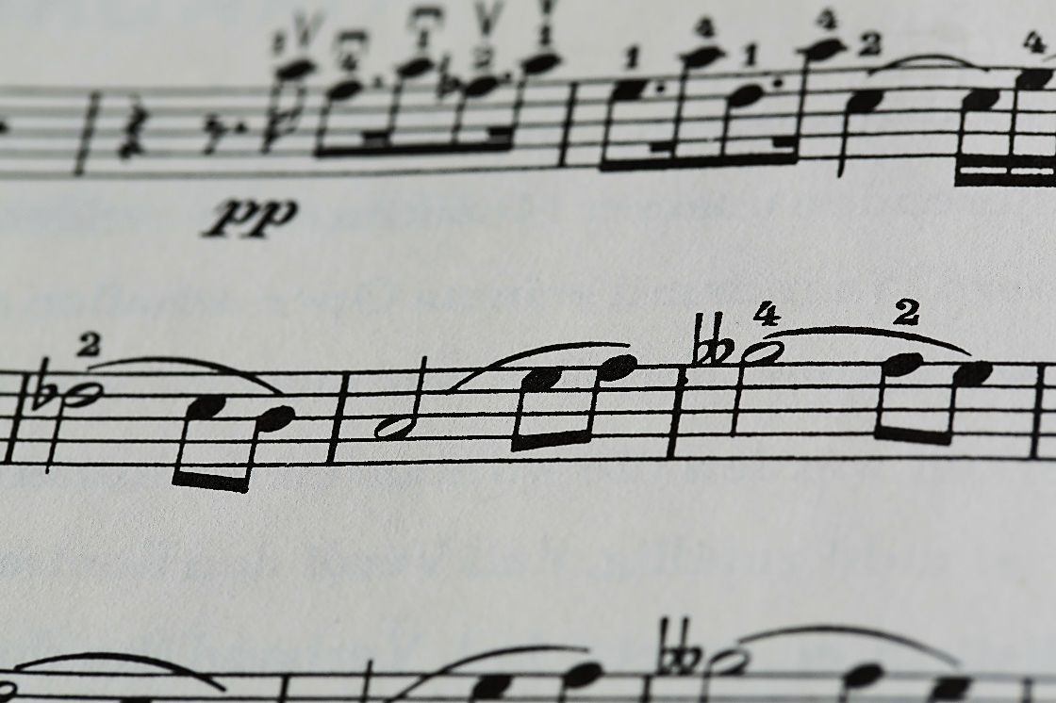

Cross Oceans Music
Music Production

Slide 2

Location
Meadowlark Complex
7125 Olympic Blvd.
Suite 471
Los Angeles, CA 90004
213-555-9000

Slide 3

Organization
Tony Raman, President
Lila Alvarez, Artistic Director
Amelia Darius, Managing Director

Slide 4



Mission
Produce music
High quality digital recordings
State-of-the art formats
Distribute music
Attract innovative artists
Attend international festivals

Slide 5

Music Genres Include
Celtic
Jazz
New Age
Reggae
Flamenco
Calypso

Slide 6
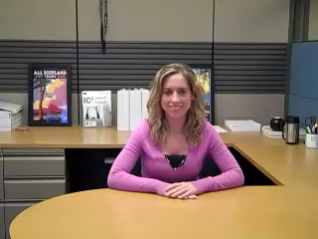
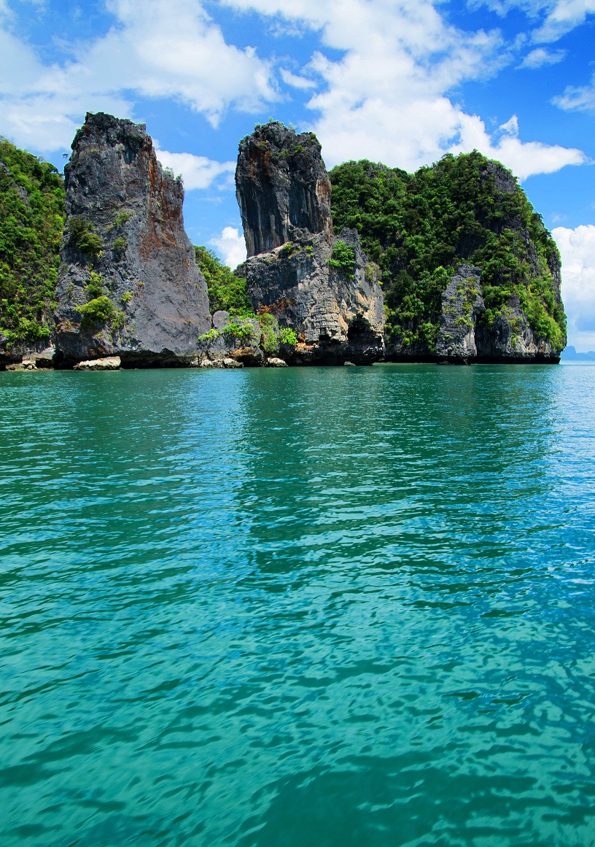
Cross Oceans
Music

